Slide 1
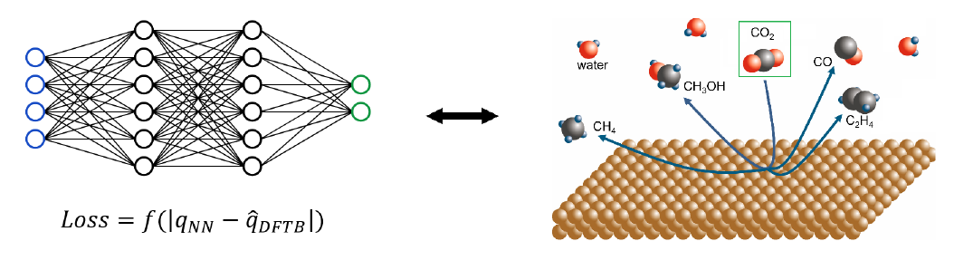
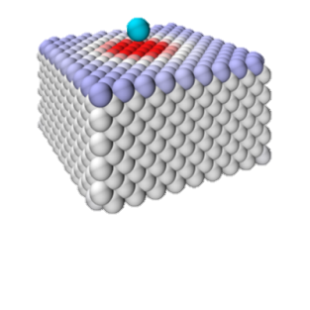
“Efficiently coupling QM and MD for the study of electrode-electrolyte interfaces”
MEP presentation by S.A.H. Hermans

Slide 2
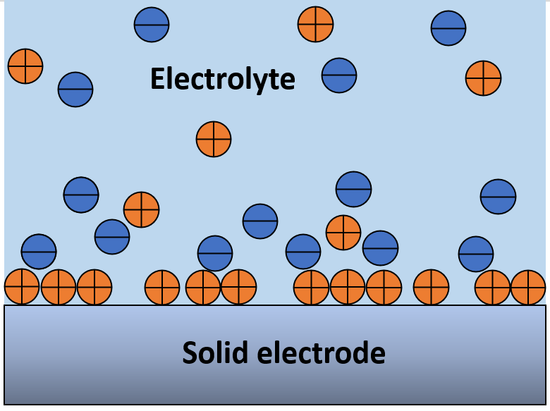
Introduction: electrode-electrolyte interface
Goal: to accurately model an electrode-electrolyte interface
Main electrochemical reactions occur at electrode-electrolyte interface
In, e.g., batteries, supercapacitors and fuel cells
Interface depends on many factors, for example:
Ions present in electrolyte
Shape of electrode
Electrostatic induction

Slide 3
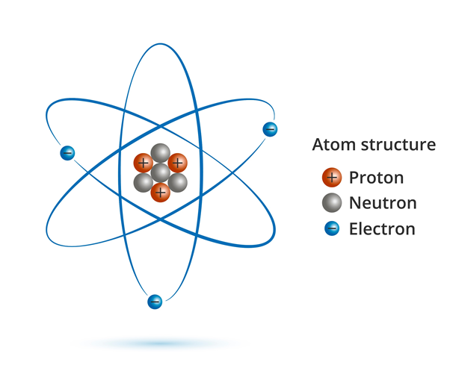
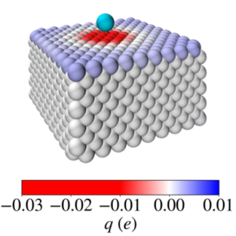
Introduction: electrode-electrolyte interface
Electrostatic induction/polarisation:
In nature charges are not fixed
Charges influence nearby charges
Can cause redistribution of charge on electrode
Can be essential for electrolyte interaction with electrode
Goal: to accurately model an electrode-electrolyte interface, taking into account electrode surface polarisation

Slide 4
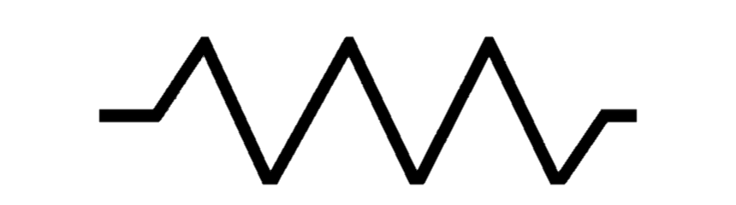
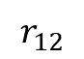
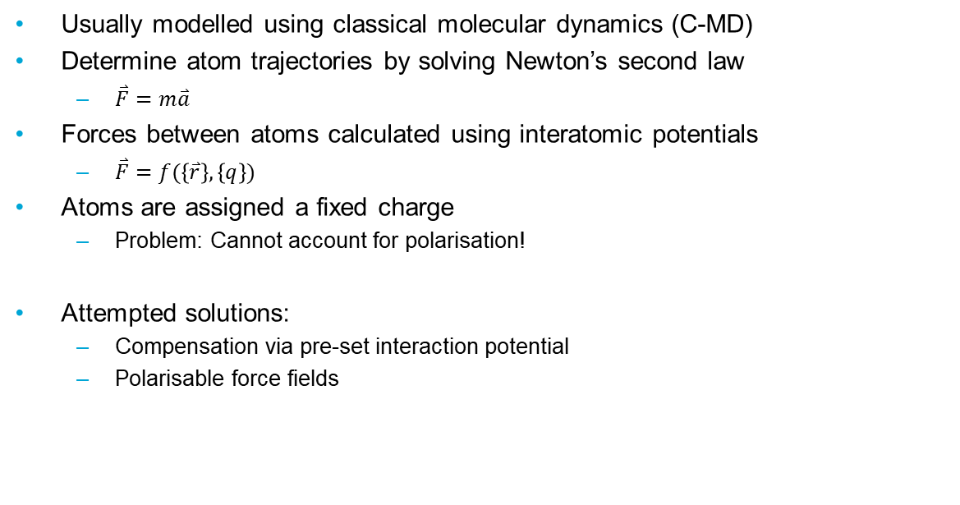
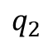
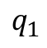
Problem: Accounting for polarisation
Usually modelled using classical molecular dynamics (C-MD)
Determine atom trajectories by solving Newton’s second law
$\overset{⃑}{F}=m\overset{⃑}{a}$
Forces between atoms calculated using interatomic potentials
$\overset{⃑}{F}=f(\left\{\overset{⃑}{r}\right\},\left\{q\right\})$
Atoms are assigned a fixed charge
Problem: Cannot account for polarisation!
Attempted solutions:
Compensation via pre-set interaction potential
Polarisable force fields
$$q_{1}$$
$$r_{12}$$
$$q_{2}$$

Slide 5
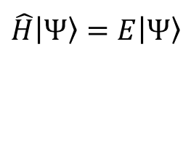
Solution: Couple QM and MD
Quantum mechanics (QM) can provide proper description
Solution: Couple QM with MD
Model charge redistribution using QM
Simulate full system in MD
QM dominates simulation time in coupled approach
Can it be replaced using machine learning?
$$\hat{H}\left|Ψ\right\rangle =E\left|Ψ\right\rangle$$

Slide 6
Content
Introduction
Molecular dynamics (MD) system under study
Quantum mechanical (QM) model
QM coupling with MD
Neural networks
Summary
Introduction
MD system
QM model
Coupled QM-MD
Neural networks
Summary

Slide 7
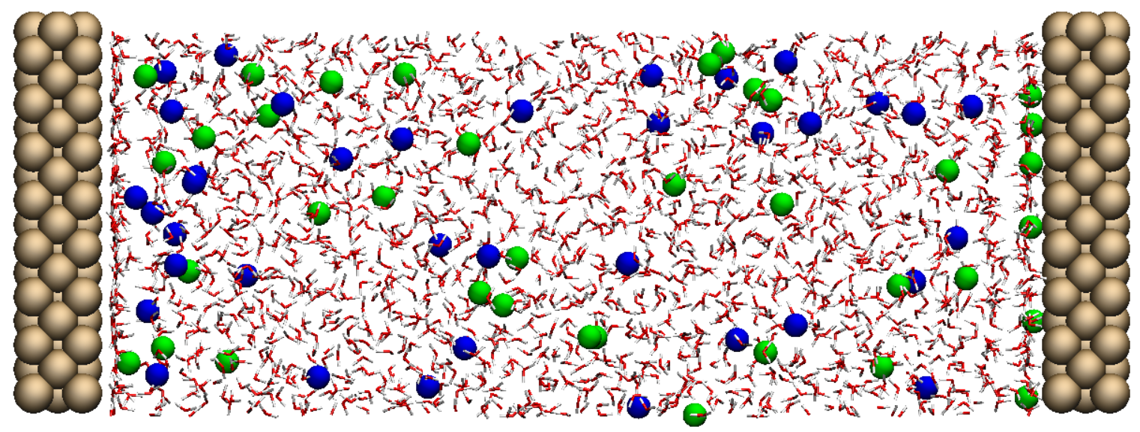
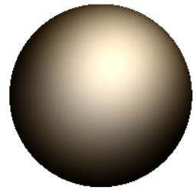


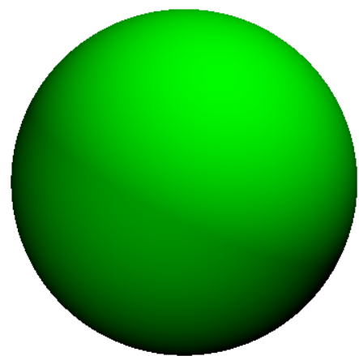


MD system
8 nm
Introduction
MD system
QM model
Coupled QM-MD
Neural networks
Summary
3 nm
- 4 e
+ 4 e
Copper
Potassium (+)
384 atoms per electrode
37 ions
37 ions
2009 molecules
Chloride (-)
Water

Slide 8
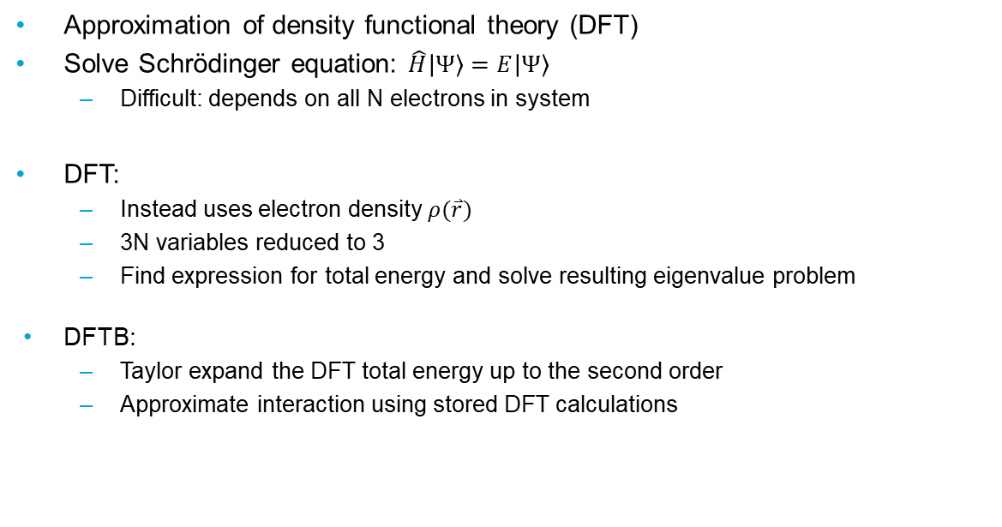
Density functional tight binding (DFTB)
Approximation of density functional theory (DFT)
Solve Schrödinger equation: $\hat{H}\left|Ψ\right\rangle =E\left|Ψ\right\rangle$
Difficult: depends on all N electrons in system
DFT:
Instead uses electron density $ρ(\overset{⃑}{r})$
3N variables reduced to 3
Find expression for total energy and solve resulting eigenvalue problem
DFTB:
Taylor expand the DFT total energy up to the second order
Approximate interaction using stored DFT calculations
Introduction
MD system
QM model
Coupled QM-MD
Neural networks
Summary

Slide 9
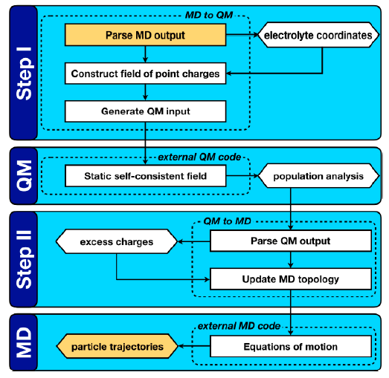

QM/MD loop
[Cathode charges]
Introduction
MD system
QM model
Coupled QM-MD
Neural networks
Summary
DFTB
Classical MD
[Atom coordinates]

Slide 10
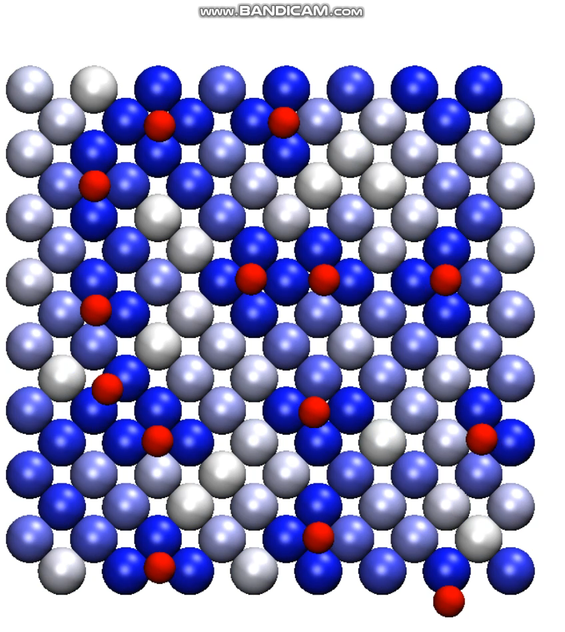
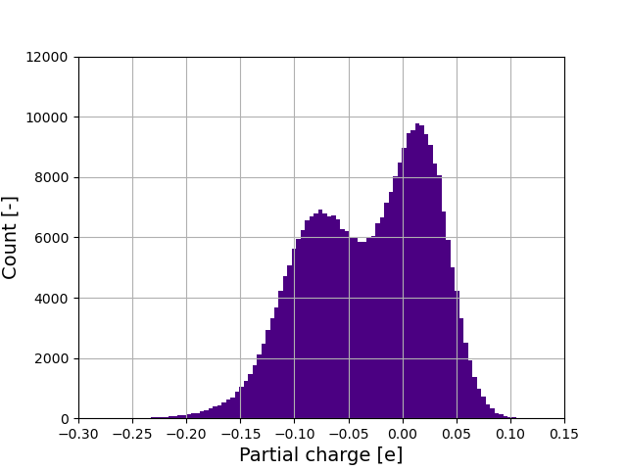
Results: charge redistribution
Negative
Neutral
Positive
Introduction
MD system
QM model
Coupled QM-MD
Neural networks
Summary

Slide 11
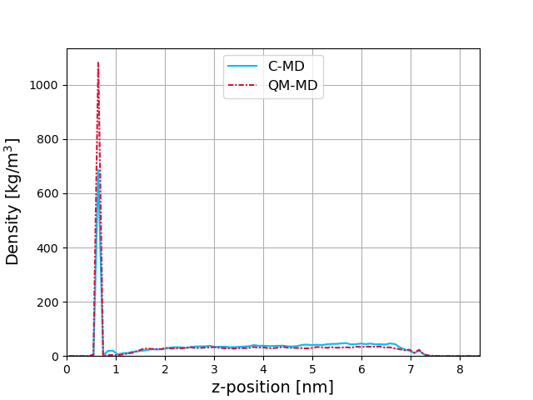
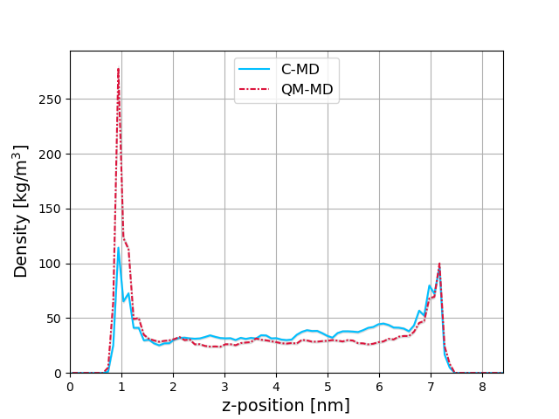
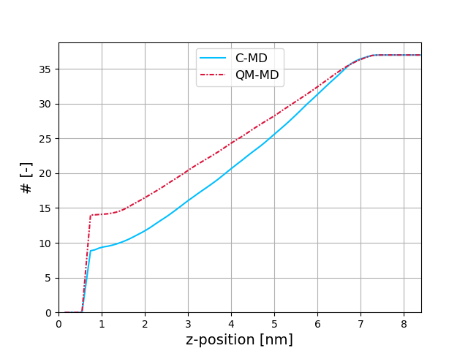
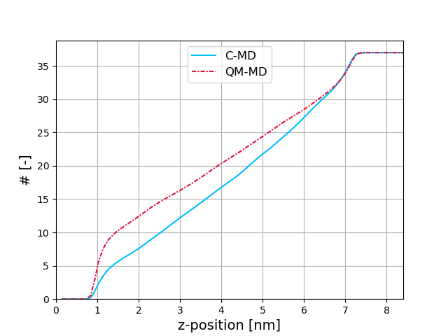
Result: ion reconfiguration
Potassium
Chloride
Mass density
Mass density
Introduction
MD system
QM model
Coupled QM-MD
Neural networks
Summary
Cumulative distribution function
Cumulative distribution function

Slide 12
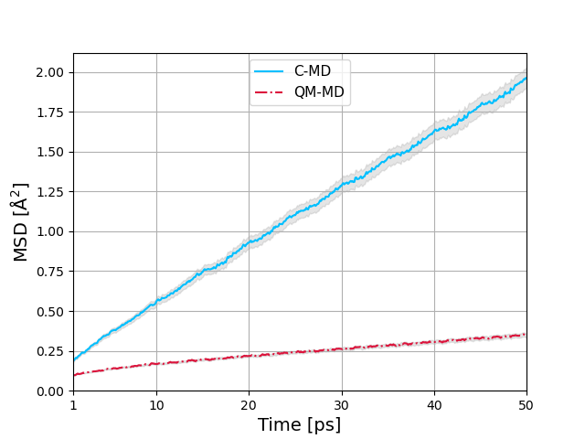
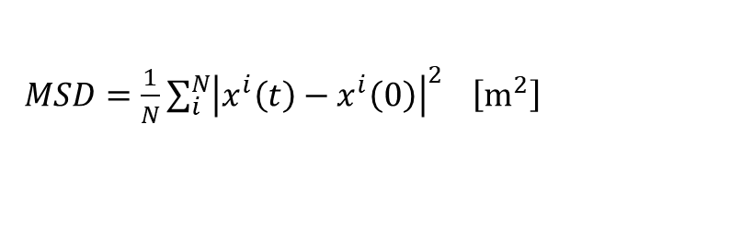
Result: mean squared displacement (MSD)
$MSD=\frac{1}{N}\sum_{i}^{N}{{\left|x^{i}\left(t\right)−x^{i}\left(0\right)\right|}^{2}} \left[m^{2}\right]$
Introduction
MD system
QM model
Coupled QM-MD
Neural networks
Summary
Computed for cations adsorbed on the cathode

Slide 13
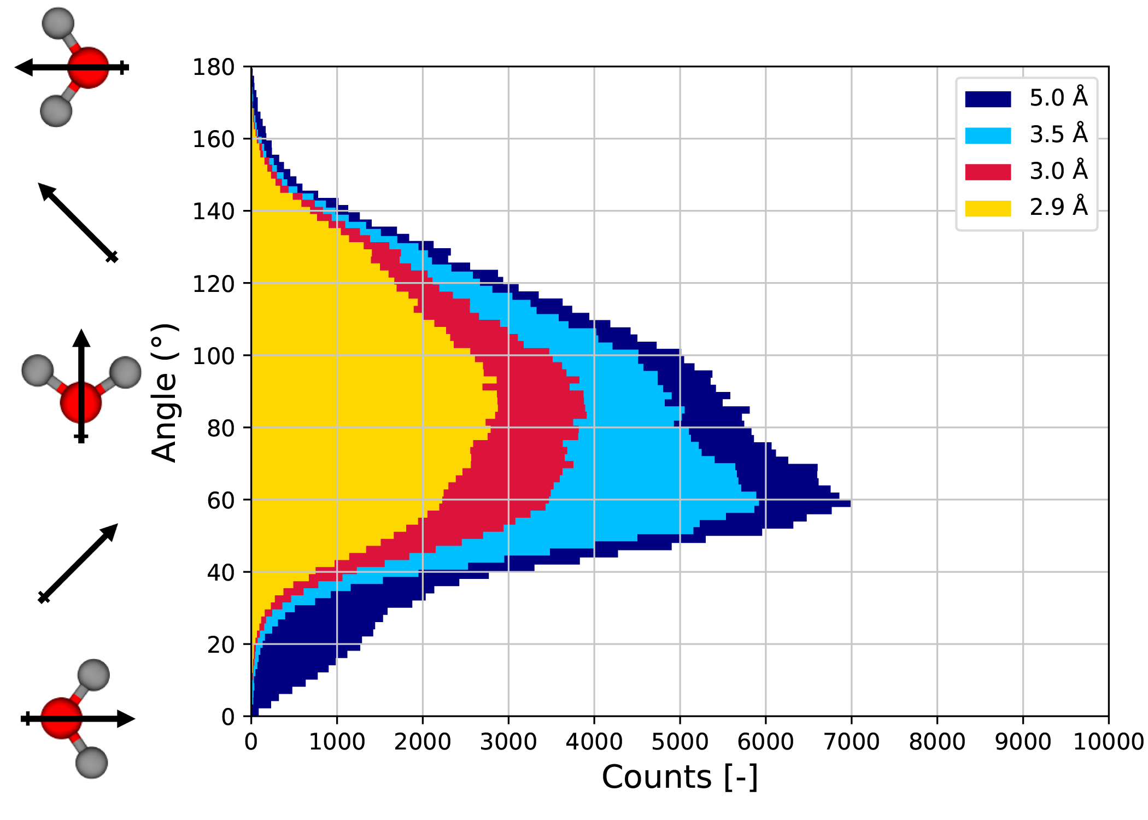
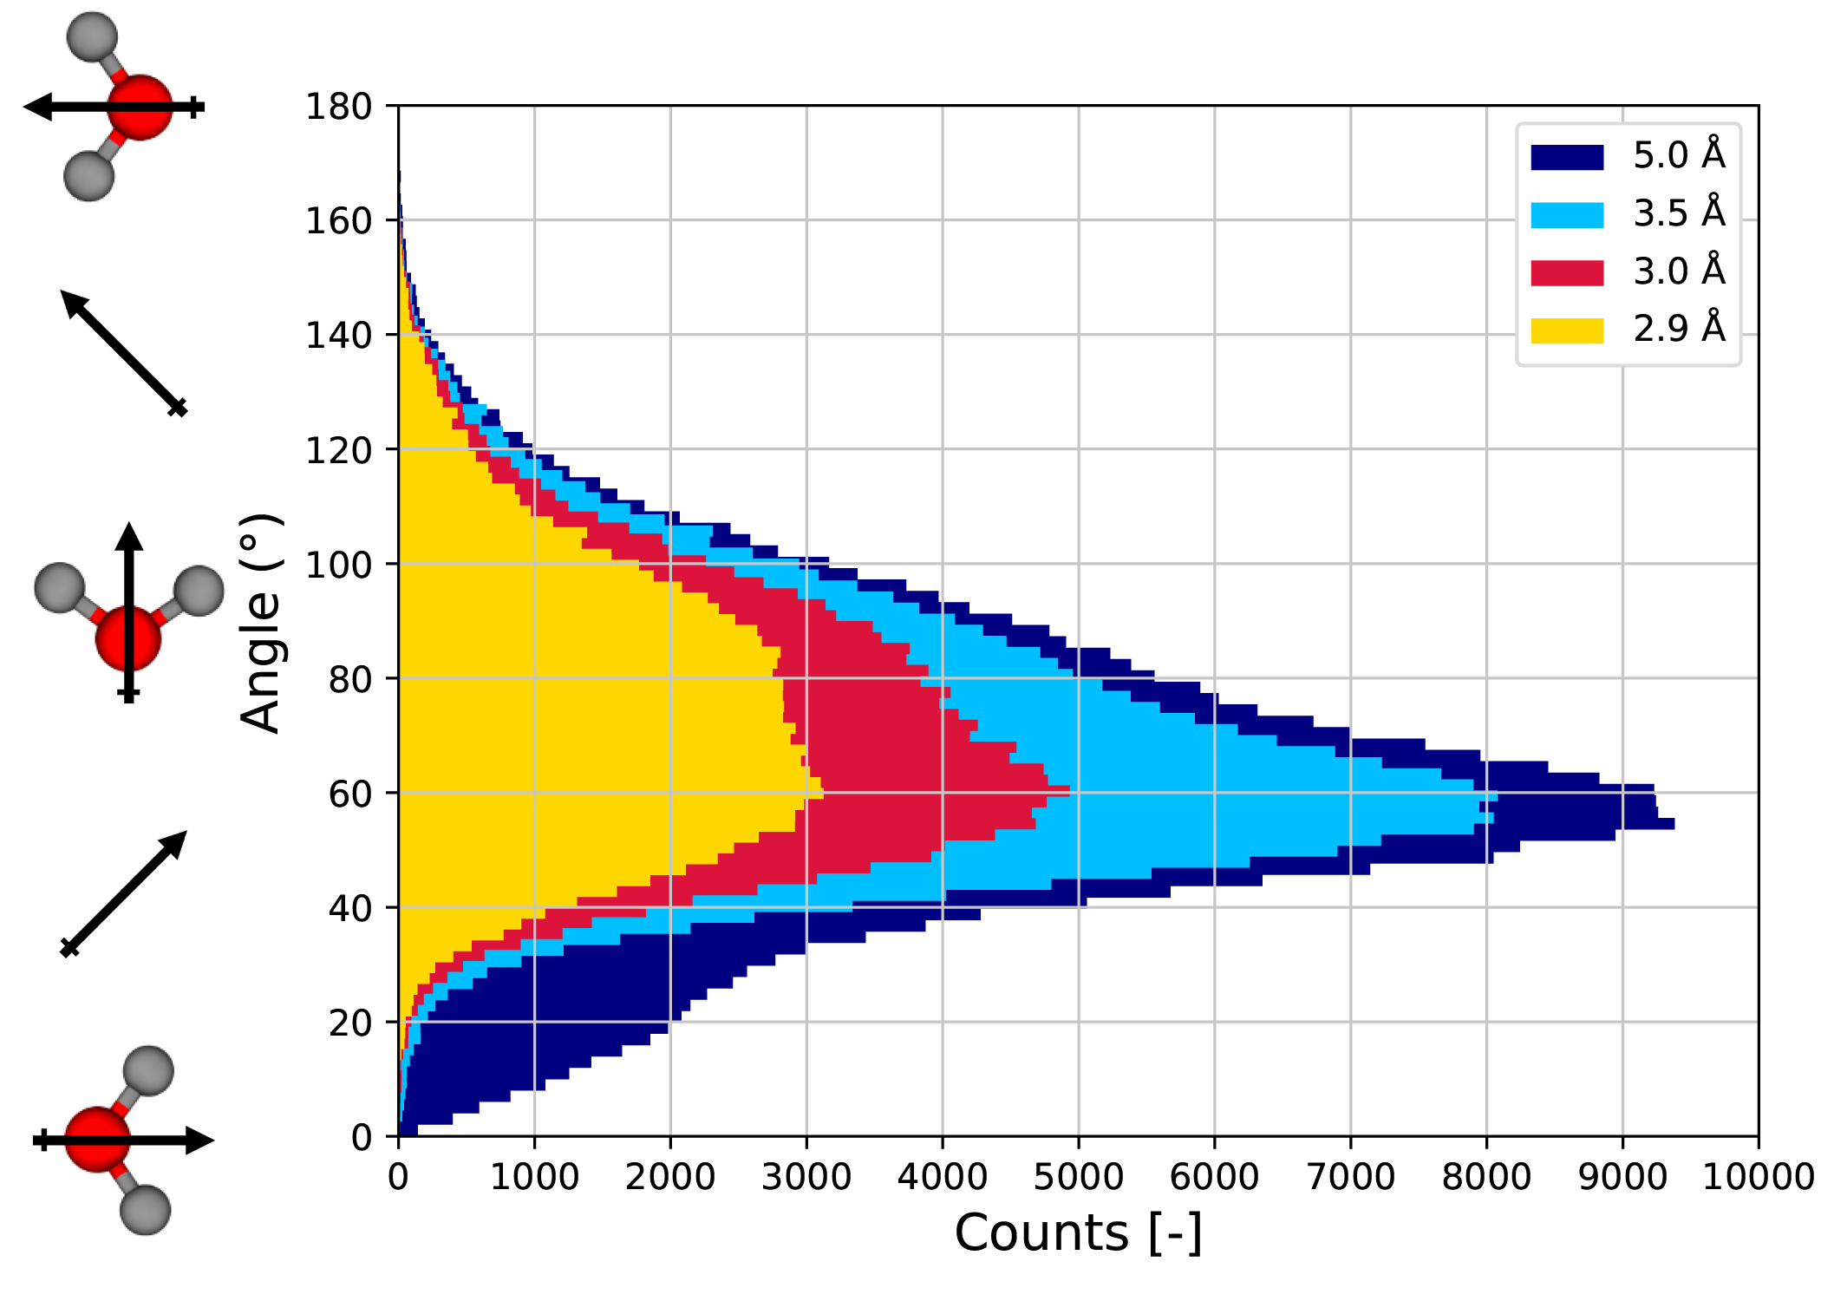
Result: angular orientation of water dipole
C-MD
QM-MD
Introduction
MD system
QM model
Coupled QM-MD
Neural networks
Summary

Slide 14
Conclusion and recommendations
Approach suitable for metallic (copper) electrode-electrolyte interface
Essential for obtaining an accurate description of the interface
How can the current approach be improved upon?
Investigate effect coupling time interval
Is a smaller interval required?
Charge transfer effects
Is charge transfer between copper and ions significant?
Model a full electrode
QM model not only the first layer
Simulate more than three layers
Use polarisable fluid model
Introduction
MD system
QM model
Coupled QM-MD
Neural networks
Summary

Slide 15
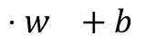
Neural networks
$$⋅w +b$$
Introduction
MD system
QM model
Coupled QM-MD
Neural networks
Summary
Input
Output
Loss:
(output – target)

Slide 16


Fully connected neural network
Introduction
MD system
QM model
Coupled QM-MD
Neural networks
Summary
Array of cartesian coordinates of ions
Charges on cathode
$$Loss=\frac{1}{N}∑\left|q_{pred}−\hat{q}\right|$$
$$+\frac{1}{N}\left|\left(∑\left|q_{pred}\right|−∑\left|\hat{q}\right|\right)\right|$$
C-MD

Slide 17
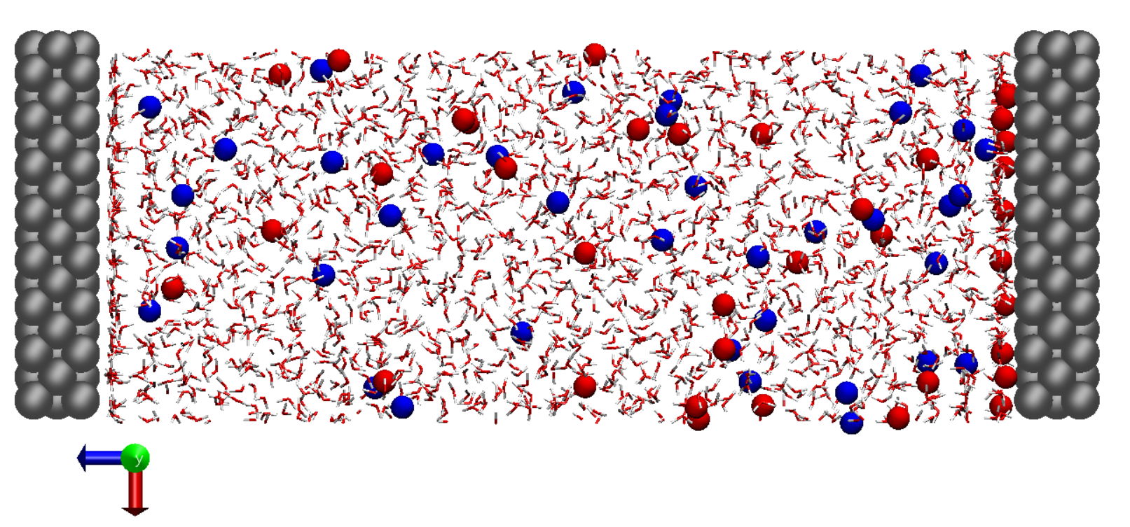
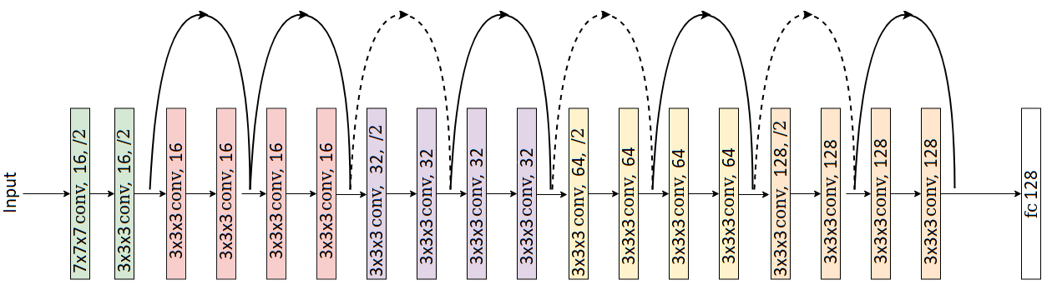
Convolutional neural network
0 | 0 | 0 | 0 | 0 | 0
0 | 0 | 0 | 0 | 0 | 0
0 | 0 | 0 | 0 | 0 | 0
0 | 0 | 0 | 0 | 0 | -1
0 | 1 | 0 | 0 | 0 | 0
0 | 0 | 0 | 0 | 0 | 0
0 | 0 | +1 | 0 | 0 | 0
0 | 0 | 0 | 0 | 0 | 0
0 | 0 | 0 | 0 | 0 | 0
0 | 0 | 0 | 0 | 0 | 0
0 | 1 | 0 | 0 | 0 | 0
0 | 0 | 0 | 0 | 0 | 0
Introduction
MD system
QM model
Coupled QM-MD
Neural networks
Summary
0 | 0 | +1 | 0 | 0 | 0
0 | +1 | -1 | 0 | +1 | -1
-1 | 0 | 0 | -1 | 0 | 0
0 | 0 | 0 | 0 | 0 | 0
0 | 0 | 0 | 0 | 0 | 0
0 | -1 | 0 | 0 | 0 | 0
y
z
y
z
x
x

Slide 18
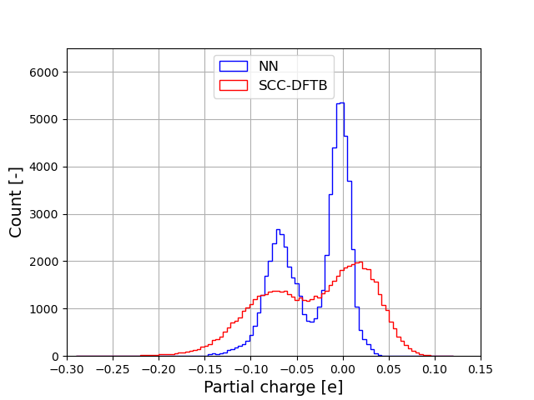
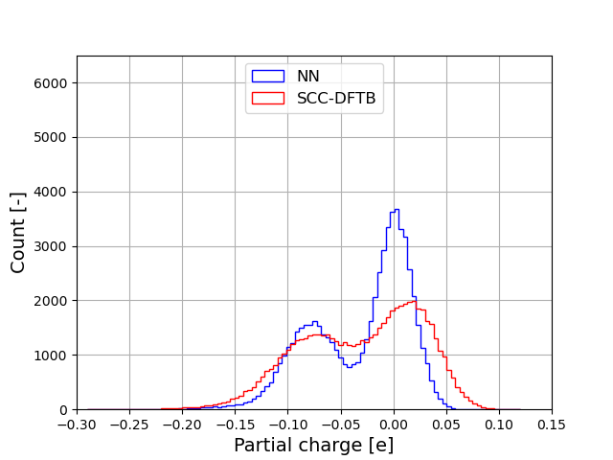
NN results: charge distribution
Fully connected network
Convolutional network
Introduction
MD system
QM model
Coupled QM-MD
Neural networks
Summary

Slide 19
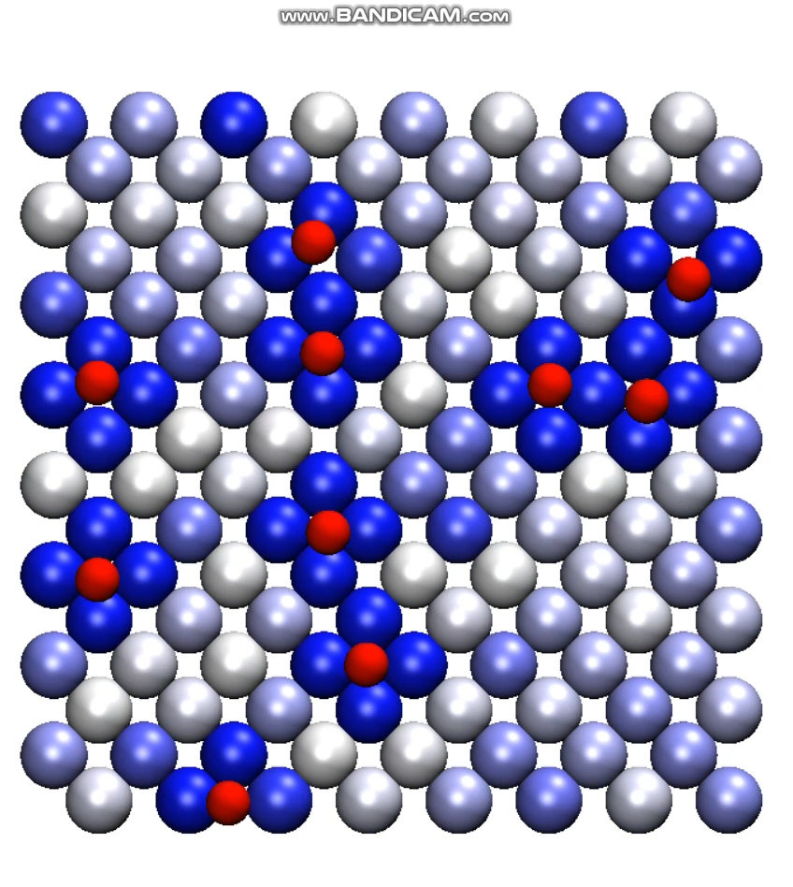
NN-MD results: video
Introduction
MD system
QM model
Coupled QM-MD
Neural networks
Summary

Slide 20
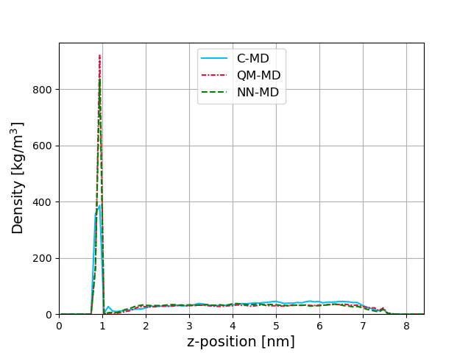
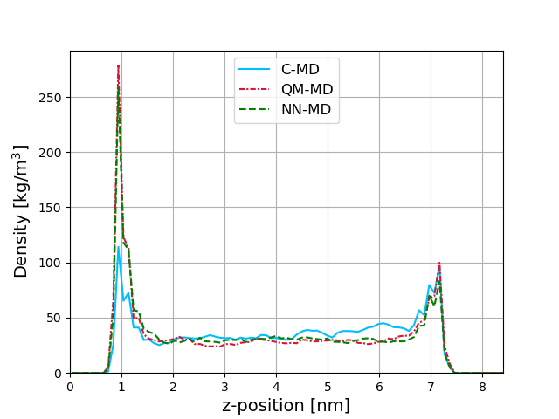
NN-MD results: density profiles
Introduction
MD system
QM model
Coupled QM-MD
Neural networks
Summary
Potassium
Chloride

Slide 21
Conclusion and recommendations
Evidence indicates that neural networks can replicate DFTB predictions, even for periodic and metallic surfaces
How to improve upon this result?
Add water to input
Apply a coordinate convolution at input
Expand architecture, move to transformers
Obtain more and more suitable data
Tune the delicate training procedure
Alternative approaches:
Accelerated DFTB/MD scheme
Non-periodic convolutional scheme for electrodes of arbitrary size
Introduction
MD system
QM model
Coupled QM-MD
Neural networks
Summary

Slide 22
Summary
Problem: Classical MD does not account for induced charges
Solution: QM-MD loop
Established proof of concept for metallic electrode-electrolyte interfaces
Showed that polarisation effects are essential for obtaining accurate description
New problem: QM slow
Solution: Try to replace QM by a neural network
Provided evidence that indicates that it is possible use neural networks for charge induction predictions periodic metallic surfaces
Introduction
MD system
QM model
Coupled QM-MD
Neural networks
Summary

Slide 23
Questions?

Slide 24
MD system: CO₂ reduction
Carbon dioxide (CO₂) reduction:
Convert CO₂ to other molecules using electricity
Copper seen as suitable electrode material (electrocatalyst)
Applicability currently limited
Mechanistic understanding of the process on copper is lacking
Introduction
MD system
QM model
Coupled QM-MD
Neural networks
Summary

Slide 25
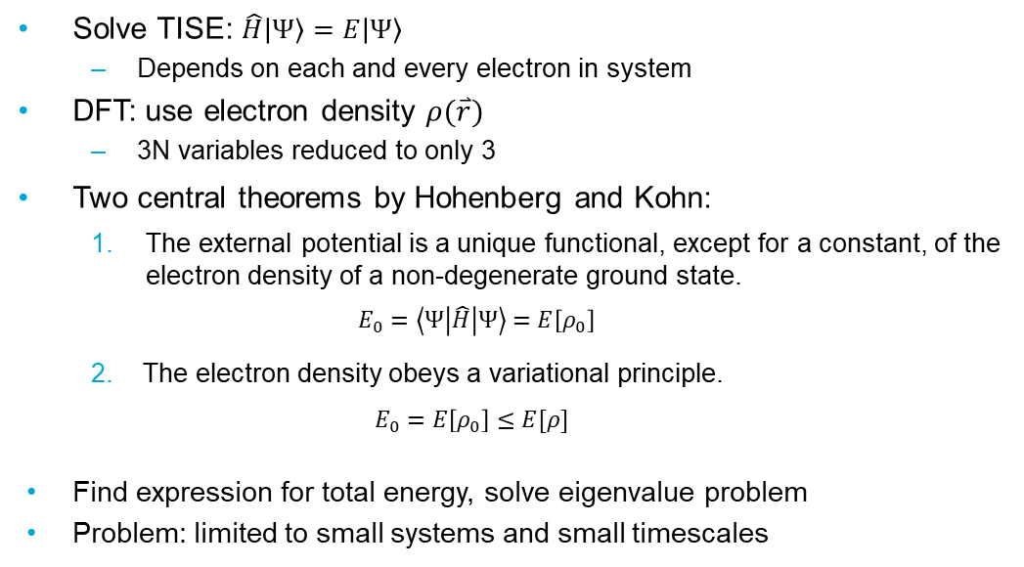
Density functional theory (DFT)
Solve TISE: $\hat{H}\left|Ψ\right\rangle =E\left|Ψ\right\rangle$
Depends on each and every electron in system
DFT: use electron density $ρ(\overset{⃑}{r})$
3N variables reduced to only 3
Two central theorems by Hohenberg and Kohn:
The external potential is a unique functional, except for a constant, of the electron density of a non-degenerate ground state.
$$E_{0}=\left\langle Ψ\left|\hat{H}\right|Ψ\right\rangle =E\left[ρ_{0}\right]$$
2. The electron density obeys a variational principle.
$$E_{0}=E\left[ρ_{0}\right]≤E[ρ]$$
Find expression for total energy, solve eigenvalue problem
Problem: limited to small systems and small timescales
Introduction
MD
QM coupling
Neural networks
Summary

Slide 26
Density functional tight binding (DFTB)
Approximation of DFT
Based on Taylor expansion of DFT total energy up to second order
Store Hamiltonian elements from DFT
Main parameters of the method
Approximate non-diagonal terms using a two-center approximation
Depend only on distance
Tight binding: Wavefunction approximated using minimal basis set
Result: no integral evaluation during run time, much faster
Introduction
MD
QM coupling
Neural networks
Summary

Slide 27
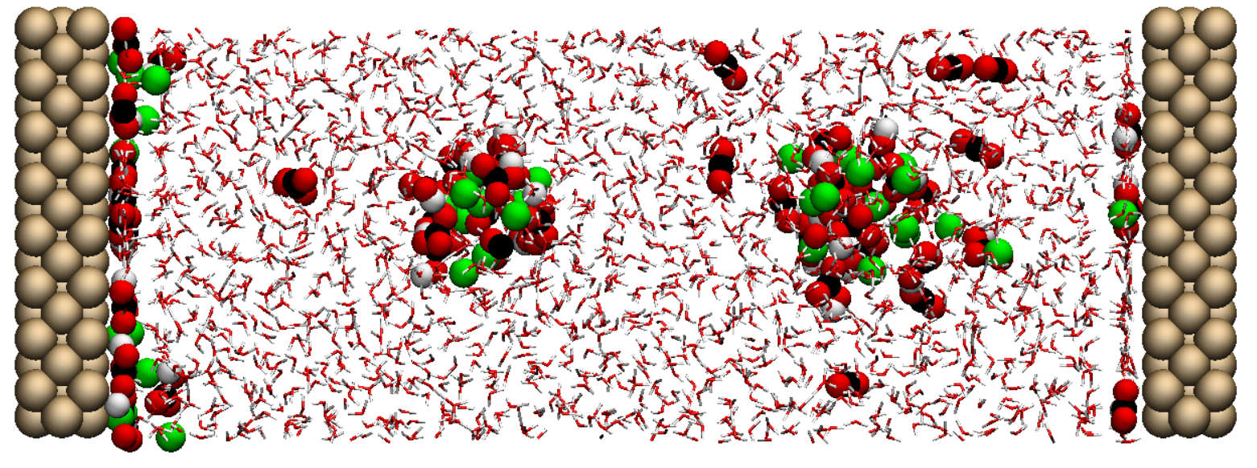
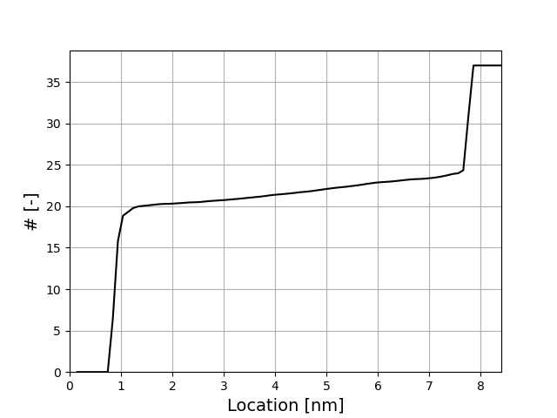
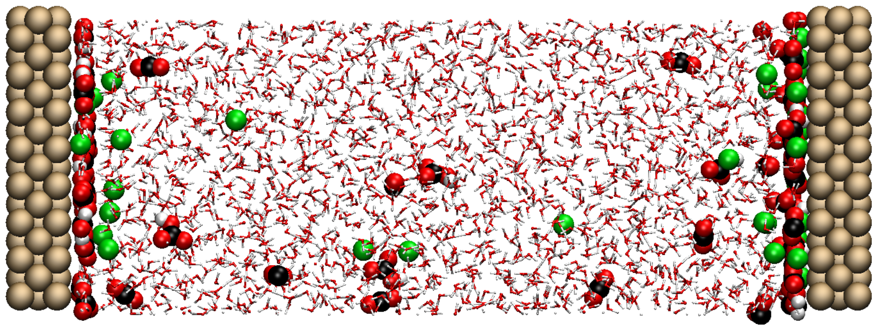
Issues with CO₂ reduction system

Slide 28
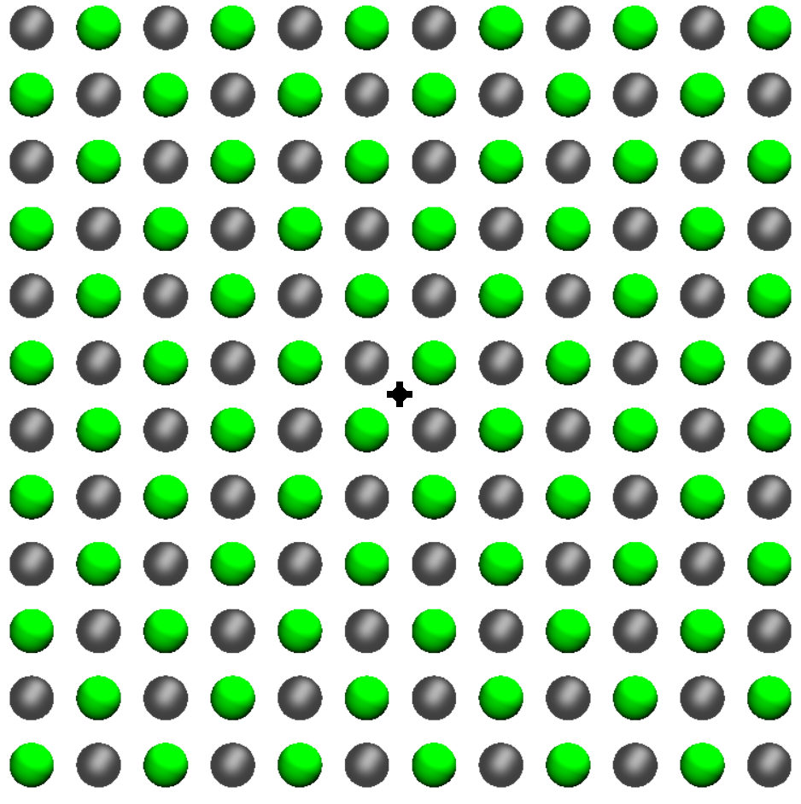
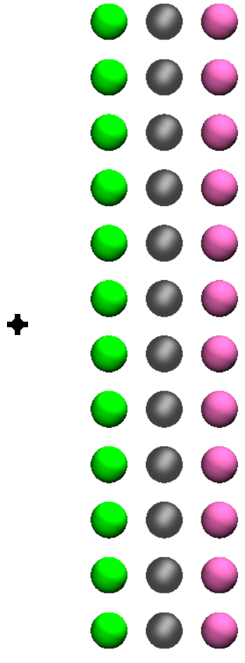
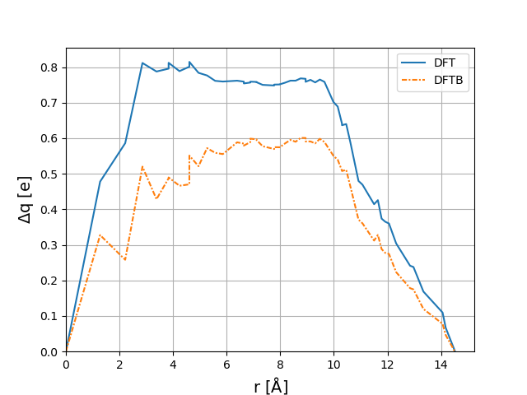
DFT/DFTB comparison: Three layers
216
Three layers

Slide 29
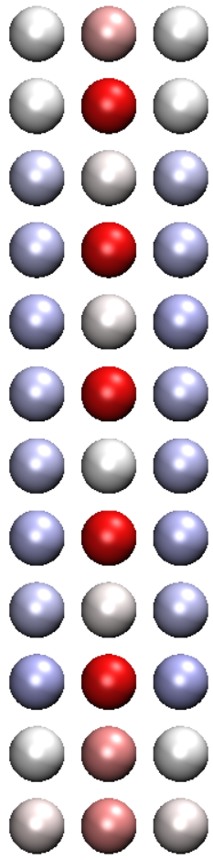
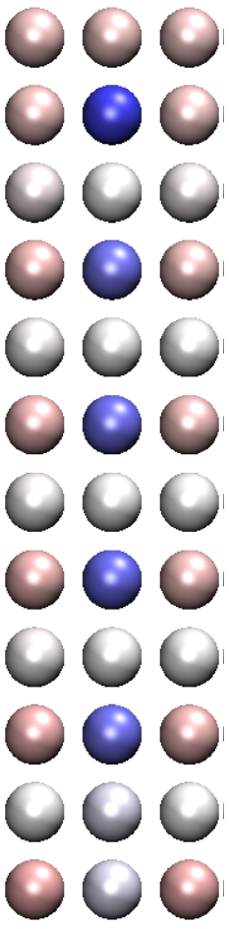
DFT/DFTB comparison: Three layers
DFT DFTB

Slide 30
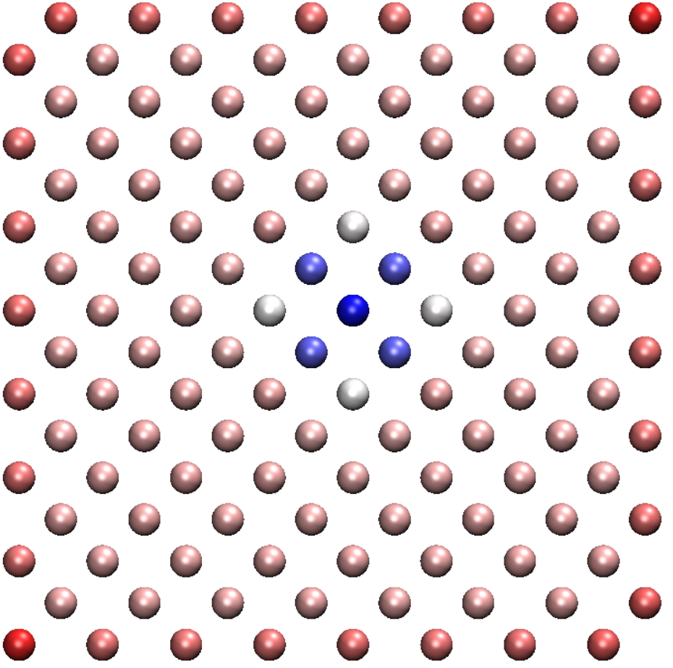
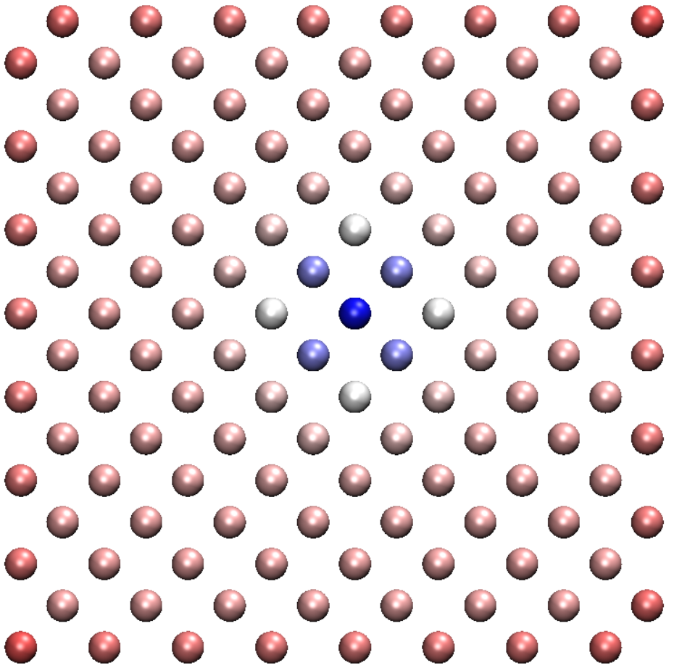
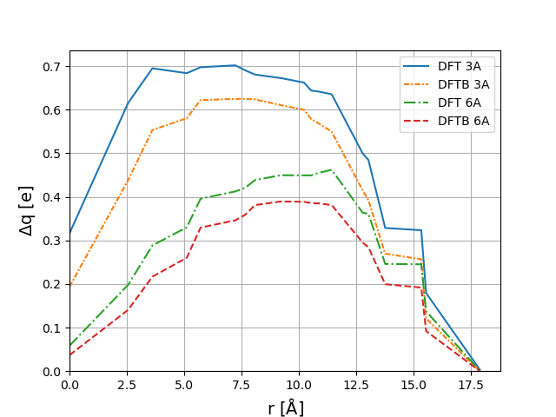
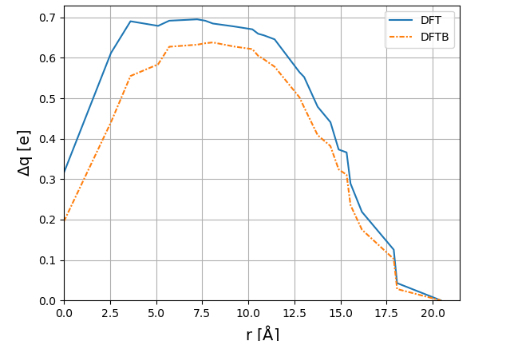
DFT/DFTB comparison: Single layer
128
One layer
113
One layer

Slide 31
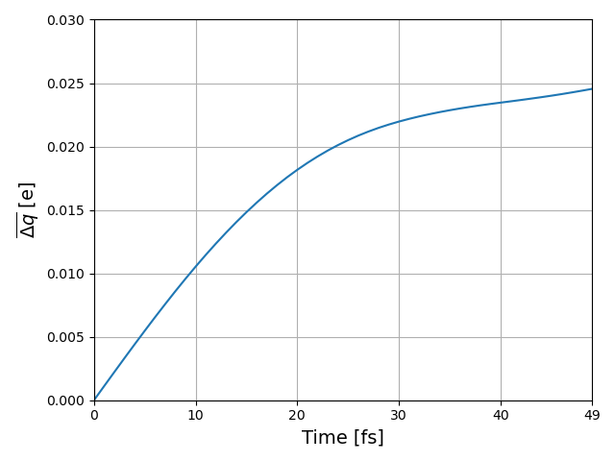
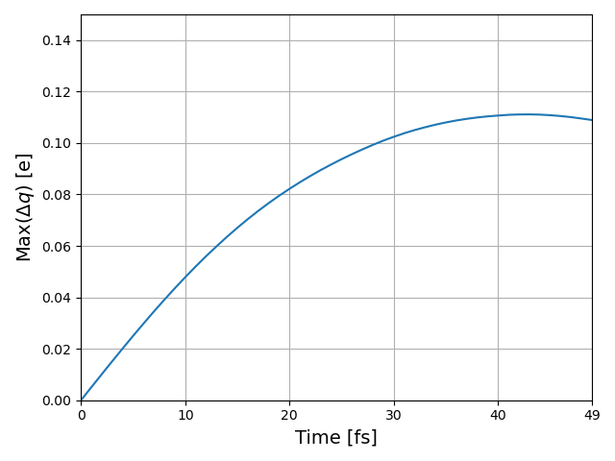
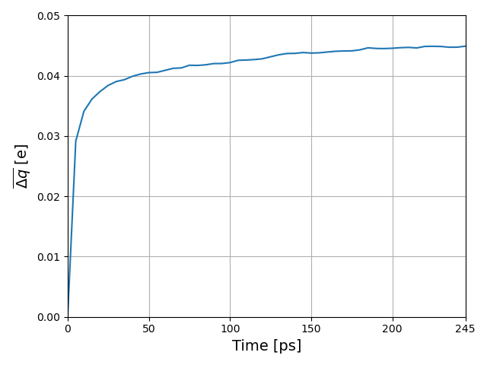

QM-MD test simulation
Time interval
between SCC-DFTB calculations:
1 fs
5 ps

Slide 32





Estimating coupling time interval
$MSD=\frac{1}{N}\sum_{i}^{N}{{\left|x^{i}\left(t\right)−x^{i}\left(0\right)\right|}^{2}} \left[m^{2}\right]$
$D=\frac{1}{2}\frac{1}{n}\frac{dMSD}{dt}$ $\left[\frac{m^{2}}{s}\right]$
$x_{gem}=\sqrt{D⋅1 ps}=0.086 Å$
$\left\lfloor 3.6149/0.86\right\rfloor =4 ps$

Slide 33


Pair correlation functions
Potassium
Chloride

Slide 34

Total density profile

Slide 35

Resulting charge difference between C-MD and QM-MD

Slide 36


MSD measurement: wall trajectories
C-MD
QM-MD

Slide 37


MSD measurements: bulk trajectories
C-MD
QM-MD

Slide 38




Diffusion coefficient
C-MD
$MSD=\frac{1}{N}\sum_{i}^{N}{{\left|x^{i}\left(t\right)−x^{i}\left(0\right)\right|}^{2}} \left[m^{2}\right]$
$D=\frac{1}{2}\frac{1}{n}\frac{dMSD}{dt}$ $\left[\frac{m^{2}}{s}\right]$
Found: $D_{xy}=1.8768±0.005 \frac{m^{2}}{s}$
Literature: $D= 1.89 \frac{m^{2}}{s}$

Slide 39


Anode angular orientation
C-MD
QM-MD

Slide 40











Neural networks
$$X_{1}$$
$$X_{1}⋅w_{1}$$
$$w_{1}$$
Input
$$Y$$
Output
$$X_{2}⋅w_{2}$$
$$w_{2}$$
$g($
$$X_{2}$$
$${(X}_{1}⋅w_{1}+X_{2}⋅w_{2})$$
$+ b$
$$)$$

Slide 41









Neural networks
$$w^{′}=w −c⋅\frac{dLoss}{dw}$$
Target = 2
$$Y=w⋅X=1$$
$$w^{′}=w+c⋅X$$
$$w^{′}=w+X=2$$
$$w=1$$
Input
$$1$$
$$Y$$
Output
If $Loss$ when $w$ then $w$ should
If $Loss$ when $w$ then $w$ should
$$Loss=2 −Y$$
$$=2 −w⋅x$$

Slide 42

Convolutional neural network

Slide 43

NN results with ResNet + water
FCN
ResNet no pooling, leaky-ReLU
ResNet with water in input

Slide 44
Convolutional (convolutional) NN
Introduction
MD
QM coupling
Neural networks
Summary

